Slide 1

EC-101 Basics of Electronics & Communication Engineering
Module-3
By
Dr. Priyank Saxena
Assistant Professor

Slide 2
Course Syllabus
Module-3 : Sinusoidal Oscillators Sinusoidal Oscillators: Concept of positive and negative feedback, Barkhausen criterion for sustained oscillations, Determination of Frequency and Condition of oscillation, Hartley and Colpitt’s oscillator. Operational Amplifiers: Operational Amplifiers: Characteristics of an Ideal and Practical Operational Amplifier (IC 741), Inverting and non-inverting amplifiers, Offset error voltages and currents; Power supply rejection ratio, Slew Rate and concept of Virtual Ground, Summing and Difference Amplifiers, Differentiator and Integrator, RC phase shift oscillator. {8 Lect. hours}
Module-4 : Logic Gates and Boolean Algebra Logic Gates and Boolean algebra: Introduction to Boolean Algebra and Boolean operators, Symbolic representation, Boolean algebraic function and Truth table of different Digital logic Gates (AND, OR, NOT, NAND, NOR, EX- OR, EX-NOR); Realization of Basic logic gates using universal gates, Adder, Subtractor, adder/subtractor. {8 Lect. hours}

Slide 3

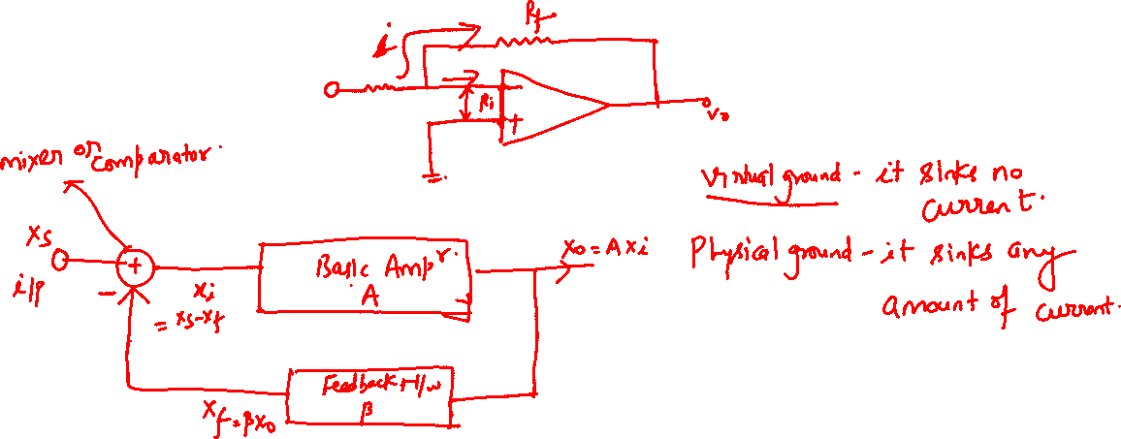
Positive and Negative Feedback

Slide 4
Positive and Negative Feedback

Slide 5
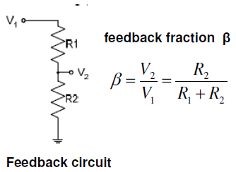
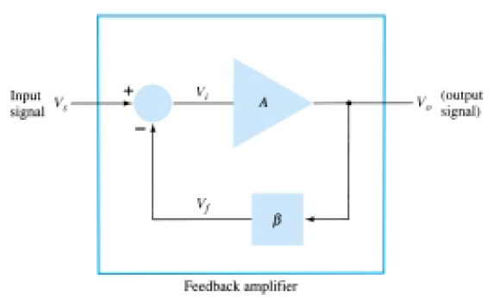

Positive and Negative Feedback
Feedback circuit:
Feedback amplifier essentially contains two component namely
i) feedback circuit ii) amplifier circuit
Feedback circuit returns a fraction of the output voltage to the input of the amplifier circuit
It is essentially a potential divider consisting
of resistances R₁ & R₂ (or impedances)
A typical feedback connection is shown in Fig
The input signal, Vs, is applied to a mixer or comparator network, where it is combined with a feedback signal, V_{f}.
The difference of these signals, V_{i}, is then the input voltage to the amplifier.
A portion of the amplifier output, V_{o}, is connected to the feedback circuit/network, which provides a reduced portion of the output as feedback signal to the input mixer network.

Slide 6
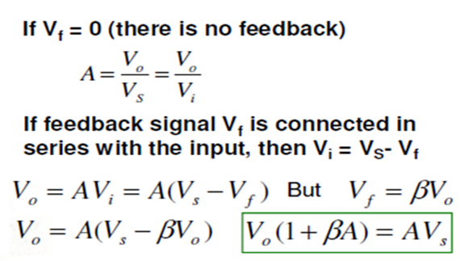

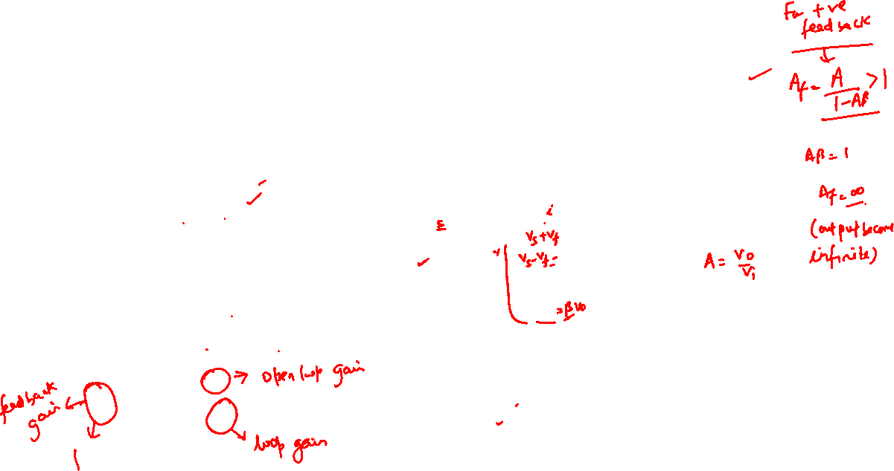
Feedback Gain
Depending on the relative polarity of the signal being fed back into a circuit, one may have negative or positive feedback
Both negative feedback and positive feedback are used with amplifier circuits
In Negative feedback returns part of the output opposes the input signal
Whereas in Positive feedback, feedback signal aids the input signal
For negative feedback: A > 0 ;
For positive feedback: A < 0

Slide 7
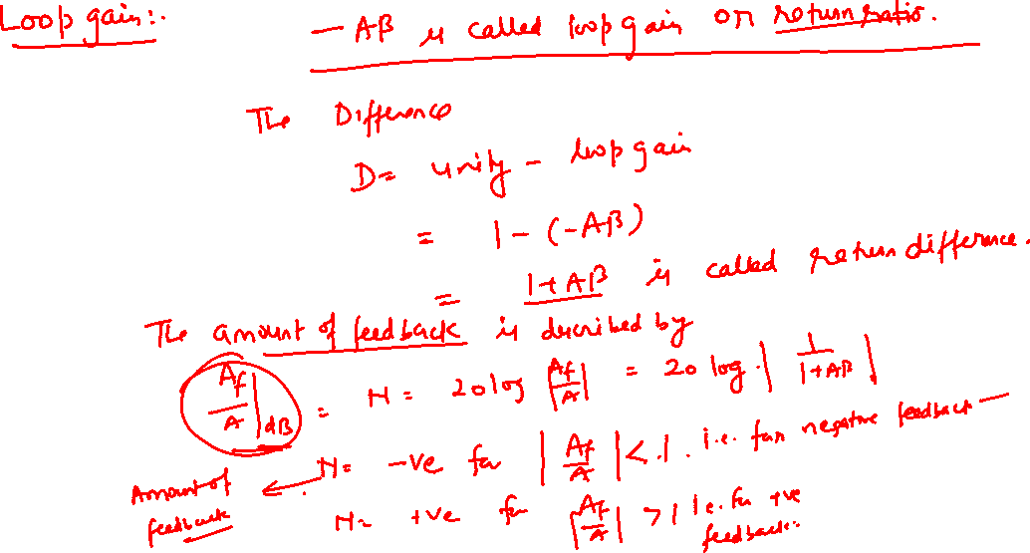

Review

Slide 8
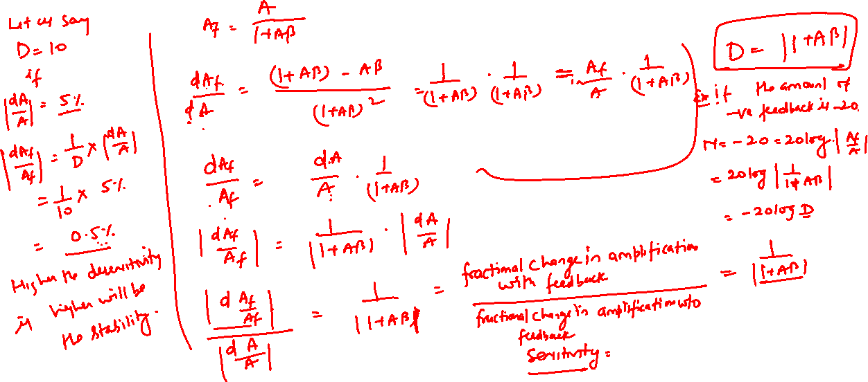

Review

Slide 9
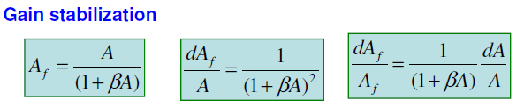
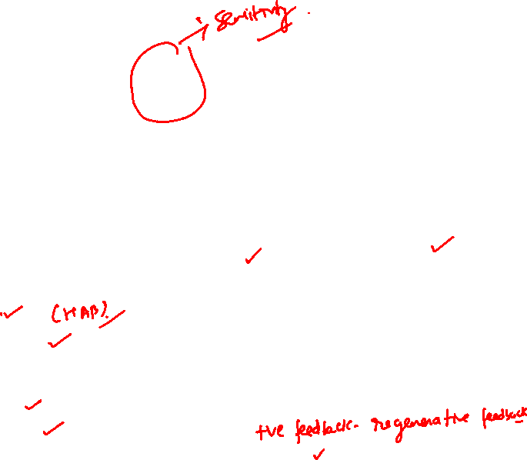
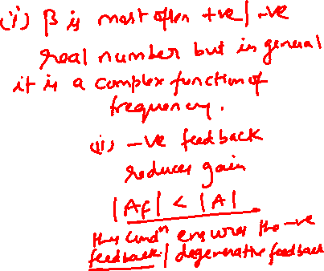
Therefore percentage change in A_{f} (due to variations in some circuit parameter) is reduced by (1+A) times compared to without feedback.
Negative feedback
Disadvantages of Negative feedback:
Negative feedback reduces the gain of the amplifier
Advantages of Negative feedback: it has many advantages
Higher input impedance.
Better stabilized voltage gain.
Improved frequency response (extension of bandwidth)
Lower output impedance.
Reduced noise.
reduction of nonlinear distortion (More linear operation)
control of input and output impedances

Slide 10


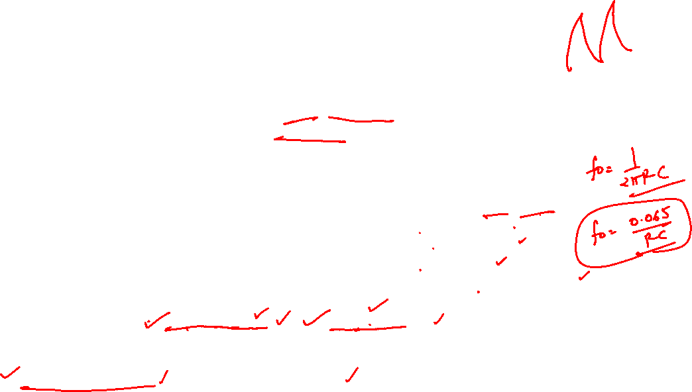
OSCILLATOR
An oscillator is a device that incorporate active and passive circuit elements to generate sinusoidal or other repetitive (periodic) waveform .
Oscillator delivers output signal voltage of a given waveform without any external input signal. Actually it converts an dc power from supply to ac power at output
Classification of Oscillator
According to the nature of generated waveform
i) Sinusoidal or Harmonic oscillator– Sinusoidal wave
ii) astable oscillators or Multivibrators – square waves (1 Hz to Several GHz used in IC)
ii) Relaxation oscillator -- Unsinusoidal (Square, Saw-tooth waveform)
iii) Sweep oscillators -- Unsinusoidal (Saw-tooth wave).
According to the component usd
i) LC oscillator ii) RC Oscillator
According to the frequency of Oscillation
i) Audio frequency Oscillator:- Oscillation frequency lie in the range:- few Hz – 20 kHz
ii) Radio frequency :- Oscillation frequency lie in the range:- 20 kHz – 30 MHz
iii) VHF frequency :- Oscillation frequency lie in the range:- 30 MHz – 300 MHz
iv) UHF frequency :- Oscillation frequency lie in the range:- 300MHz– 3GHz
v) microwave frequency :- Oscillation frequency lie in the range:- 3 GHz – Several MHz
LC feedback oscillator:- Radio Frequency
i) Tuned Oscillator ii) Hartley Oscillator ii) Colpitt Oscillator
Some time Piezoelectric crystal is used in LC known as crystal oscillator
RC feedback oscillator:- Audio Frequency
i) Phase Shift Oscillator ii) Wien Bridge Oscillator

Slide 11
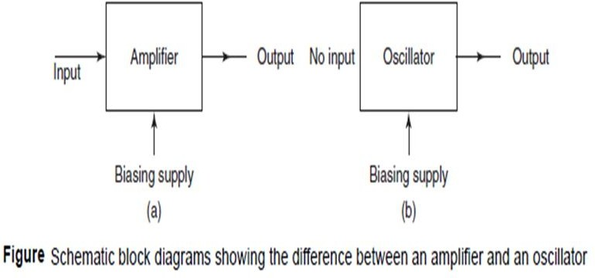
Difference between an amplifier and an oscillator:

Slide 12


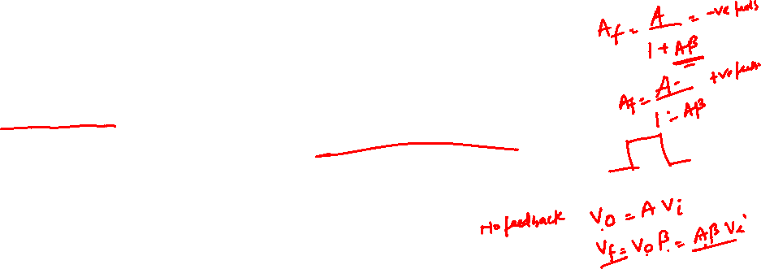
OSCILLATOR OPERATION
The use of positive feedback that
results in a feedback amplifier having closed-loop gain | Af | greater than 1 and
satisfies the phase conditions Will result in operation as an oscillator circuit.
An oscillator circuit provides a varying output signal.
If the output signal varies sinusoidal, the circuit is referred to as a sinusoidal oscillator.
If the output voltage rises quickly to one voltage level and later drops quickly to another voltage level, the circuit is generally referred to as a pulse or square-wave oscillator
To understand how a feedback circuit performs as an oscillator, consider the feedback circuit of Fig. below
When the switch at the amplifier input is open, no oscillation occurs.
Consider that we have a fictitious voltage at the amplifier input (Vi).
This results in an output voltage Vo =βA_{Vi} after the amplifier stage & voltage V_{f} = β(AVi) after the feedback stage.
Thus, we have a feedback voltage V_{f} = βAvi, where A is referred to as the loop gain.
If the circuits of the base amplifier and feedback network provide A of a correct magnitude and phase, V_{f} can be made equal to Vi.

Slide 13
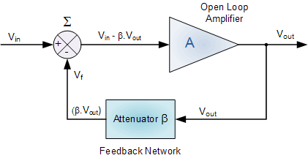
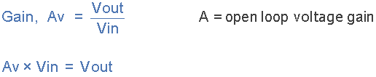
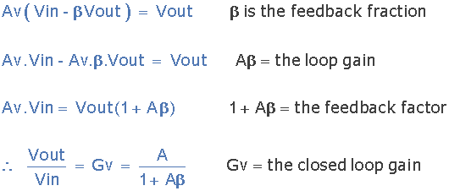

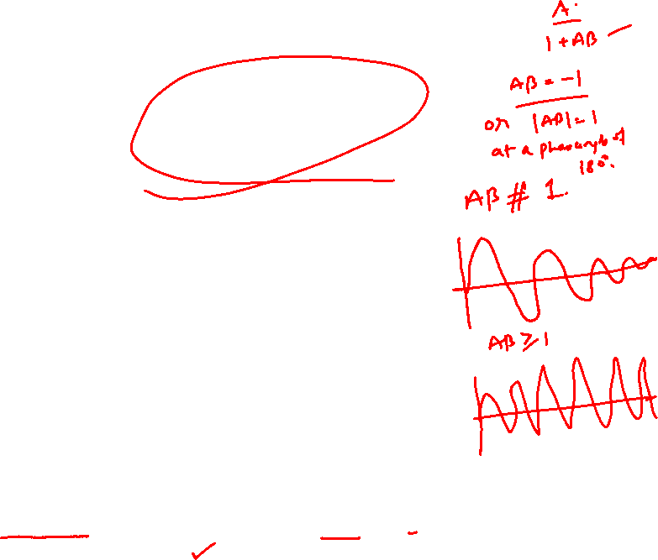
Basic Oscillator Feedback Circuit
Oscillator Gain Without Feedback
Oscillator Gain With Feedback
If V_{in} = 0 ➔ |A_{v} β| = 1
Oscillators are the circuits that generate a continuous voltage output waveform at a required frequency
This feedback network is an attenuation network which has a gain of less than one ( β <1 )
and oscillations starts when Aβ>1 which returns to unity ( Aβ =1 ) once oscillations commence and become self sustained.

Slide 14
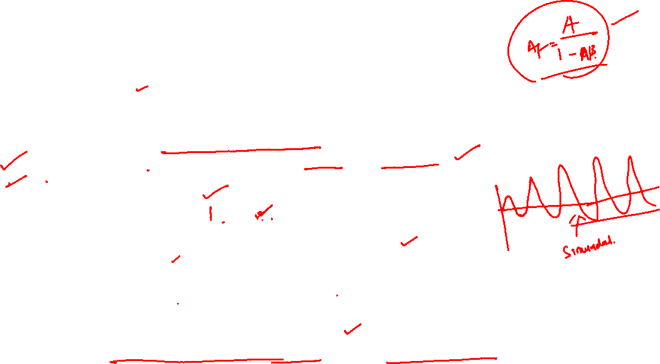

Then, when the switch is closed and fictitious voltage Vi is removed, the circuit will continue operating
since the feedback voltage is sufficient to drive the amplifier and feedback circuits resulting in a proper input voltage to sustain the loop operation.
Now the output waveform will still exist after the switch is closed if the condition | Aβ │ = 1 is met.
This is known as the Barkhausen criterion for oscillation
Barkhausen Criteria: For sustained oscillations
The total phase shift around a loop is precisely 0 degree or 360 degree. 2. The magnitude of the product of open loop gain of the amplifier and the magnitude of the feedback factor is unity. That is │Aβ│=1
In reality, no input signal is needed to start the oscillator going.
Only the condition βA=1 must be satisfied to result in self-sustained oscillations.
In practice, βA is made greater than 1 and the system is started oscillating by amplifying noise voltage, which is always present.
Saturation factors in the practical circuit provide an “average” value of βA of 1.
The resulting waveforms are never exactly sinusoidal.
However, the closer the value βA is to exactly 1 ➔ more nearly sinusoidal is the waveform.

Slide 15
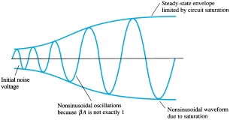
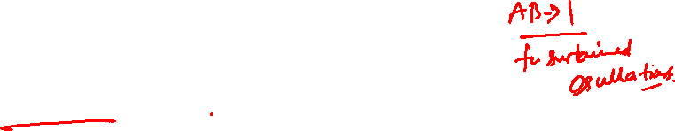

Buildup of steady-state oscillations.
Another way of seeing how the feedback circuit provides operation as an oscillator is obtained by noting the denominator in the basic feedback equation, Af =A/(1 + βA).
When βA = -1 or magnitude -1 at a phase angle of 180°,
the denominator becomes 0 and the gain with feedback, Af, becomes infinite.
Thus, an infinitesimal signal (noise voltage) can provide a measurable output voltage, and the circuit acts as an oscillator even without an input signal.

Slide 16
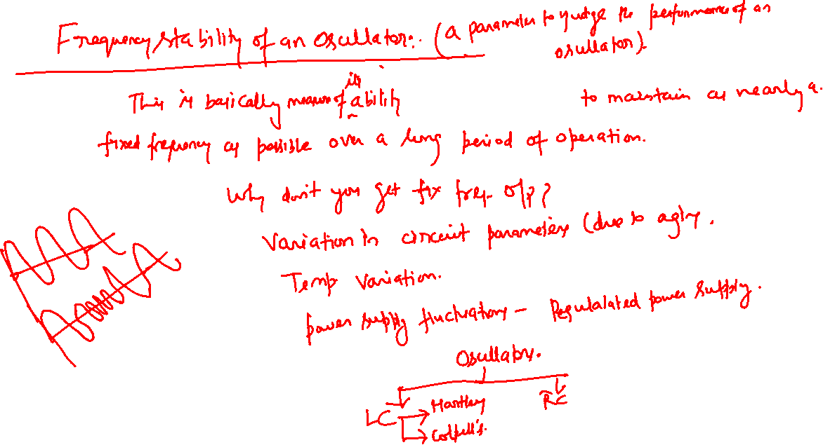


Slide 17
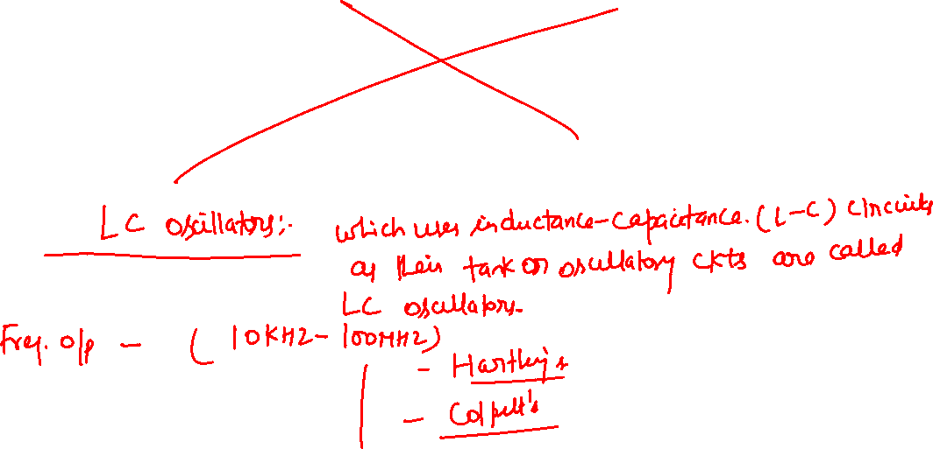

Slide 18
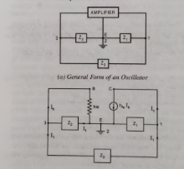
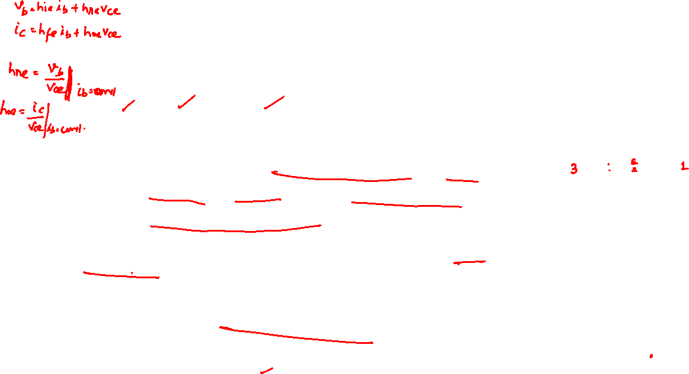
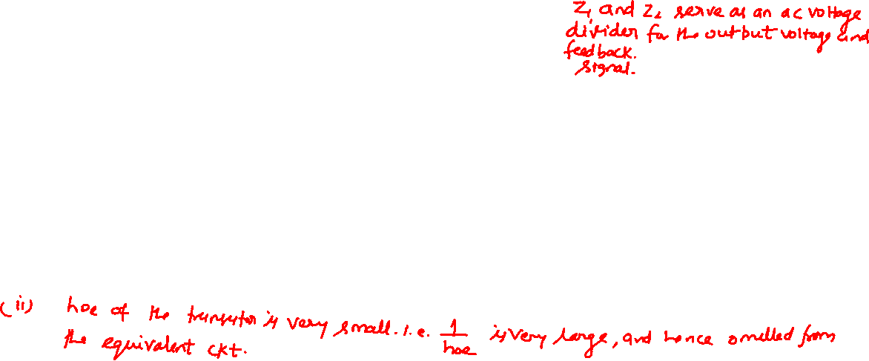
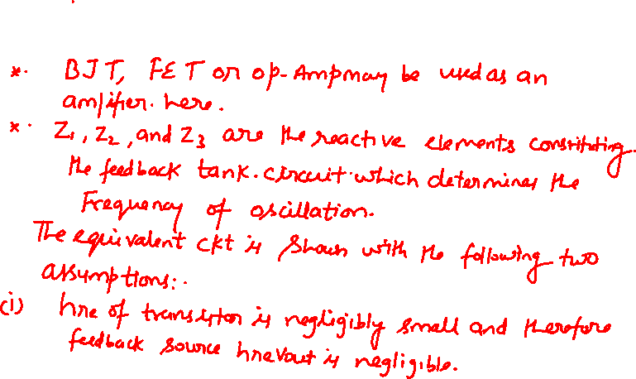
CIRCUIT ANALYSIS OF A GENERAL OSCILLATOR
The generalized circuit of an oscillator is considered using a simple transistor-equivalent circuit model. The current voltage expressions are expressed as follows:

Slide 19
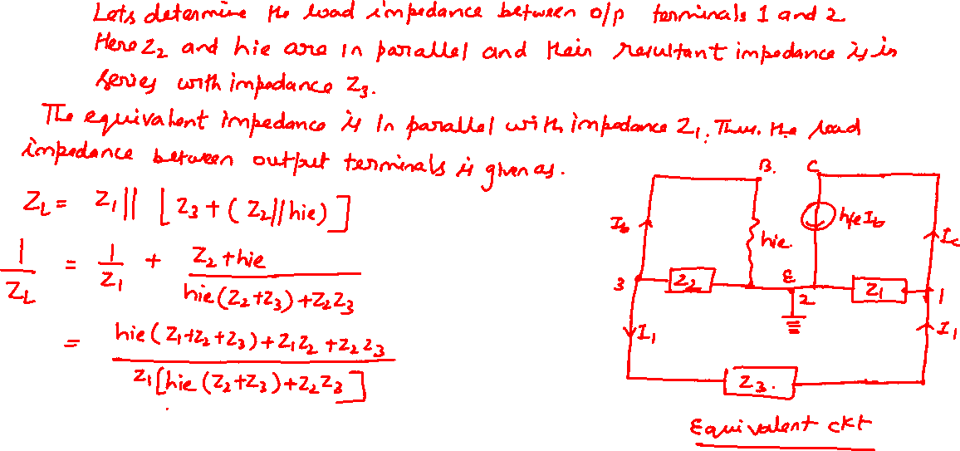
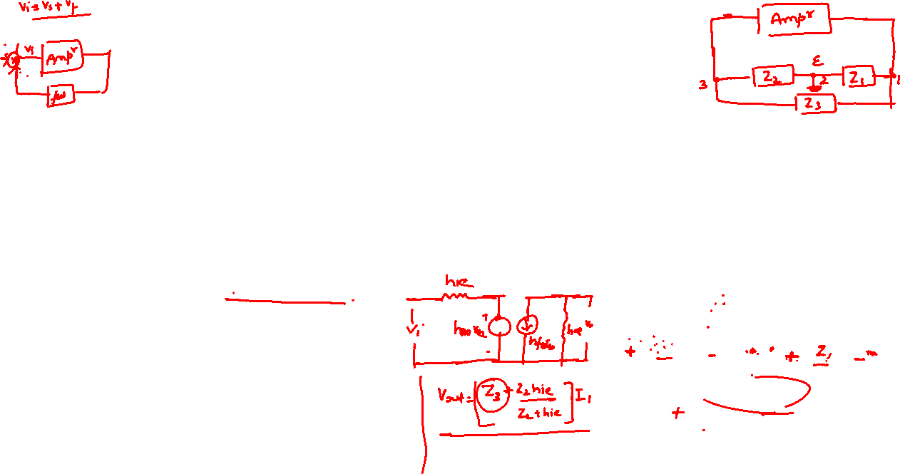

CIRCUIT ANALYSIS OF A GENERAL OSCILLATOR:

Slide 20
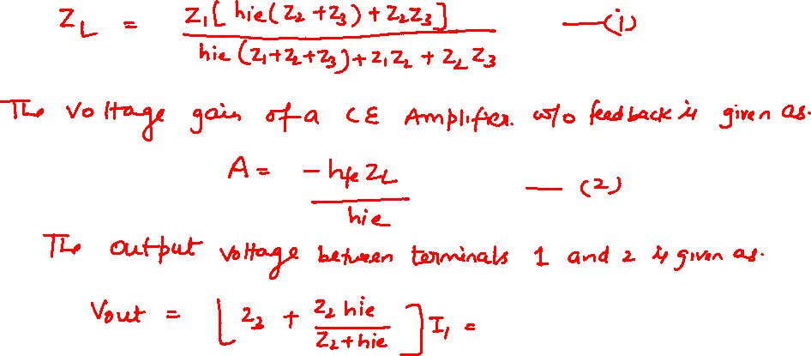


CIRCUIT ANALYSIS OF A GENERAL OSCILLATOR:

Slide 21
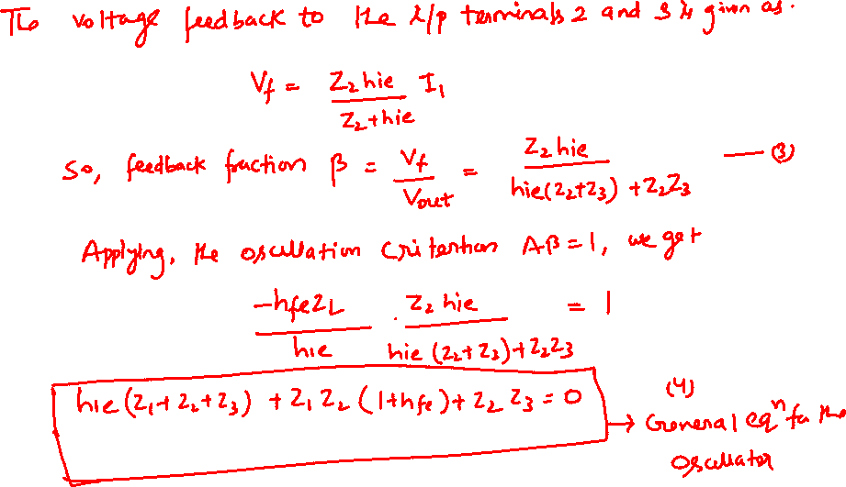

CIRCUIT ANALYSIS OF A GENERAL OSCILLATOR:

Slide 22
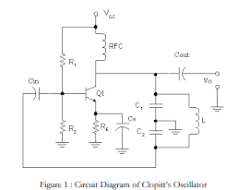
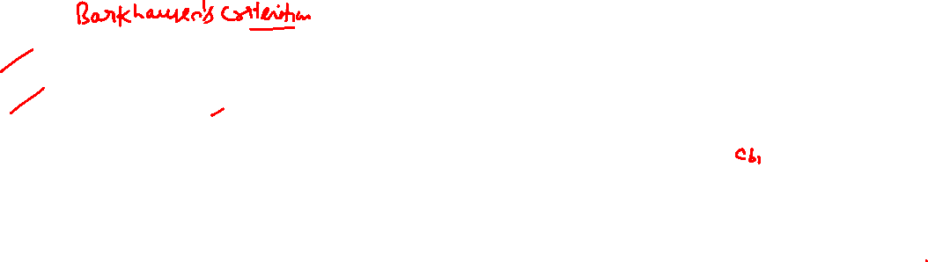
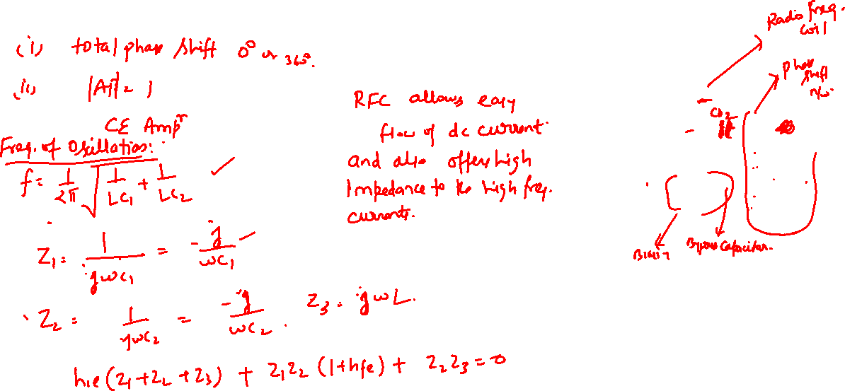


Colpitts Oscillator:

Slide 23
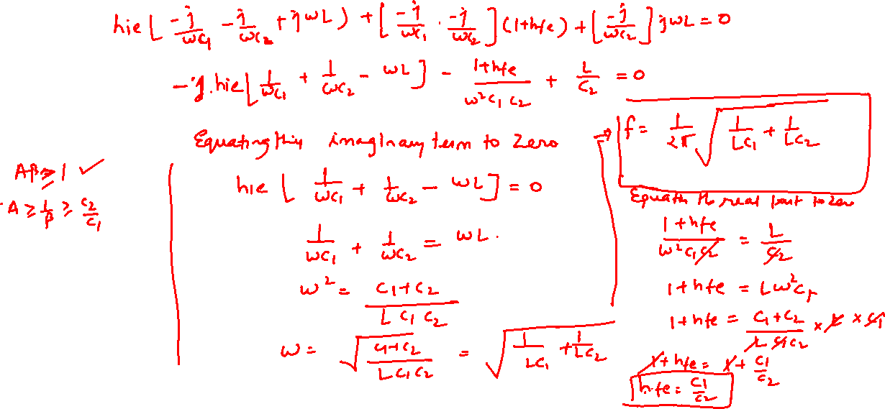
Colpitts Oscillator:

Slide 24
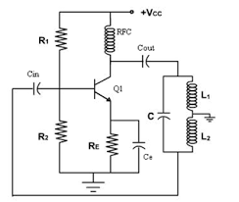
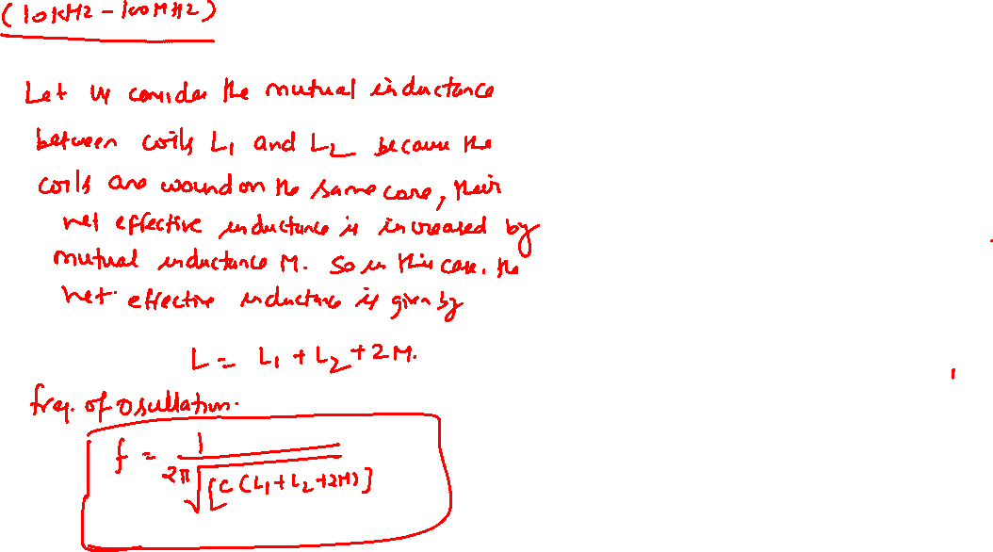

Hartley Oscillator:

Slide 25
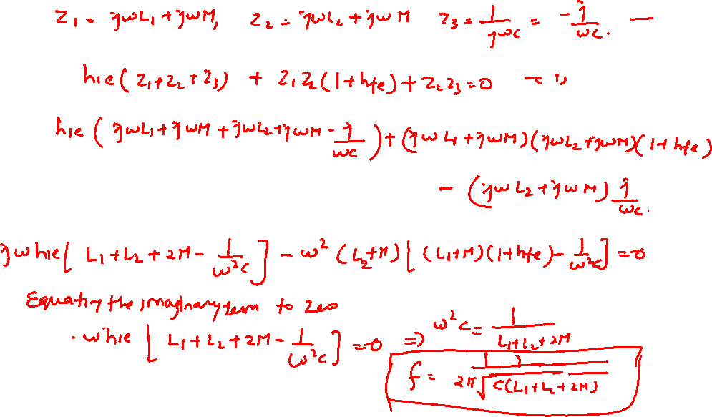
Hartley Oscillator:

Slide 26
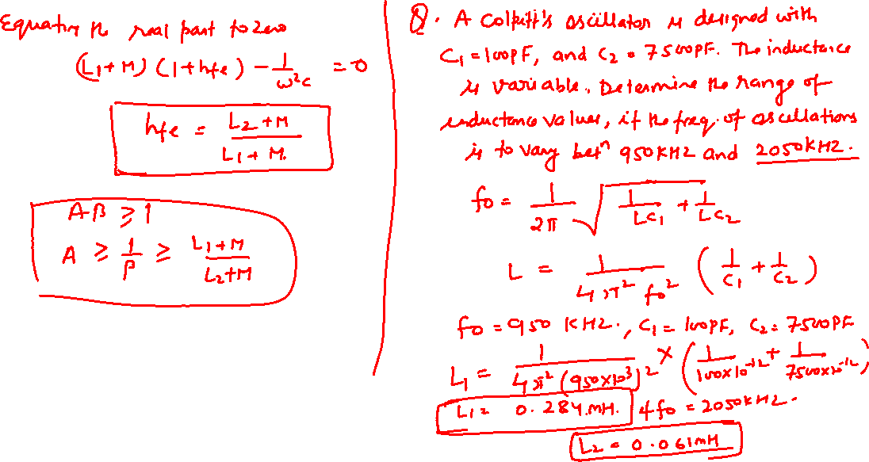
Hartley Oscillator

Slide 27
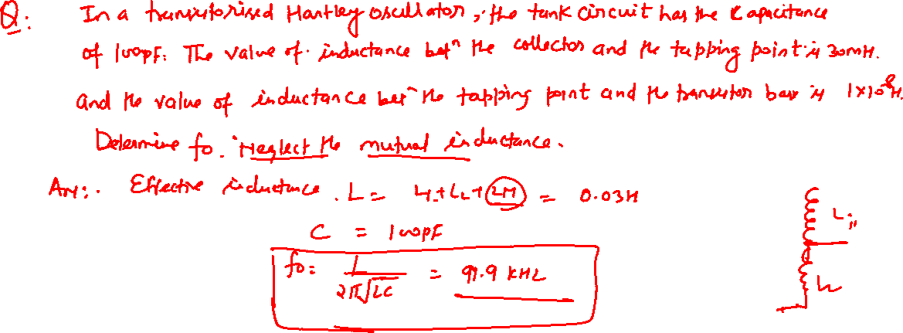

Slide 28
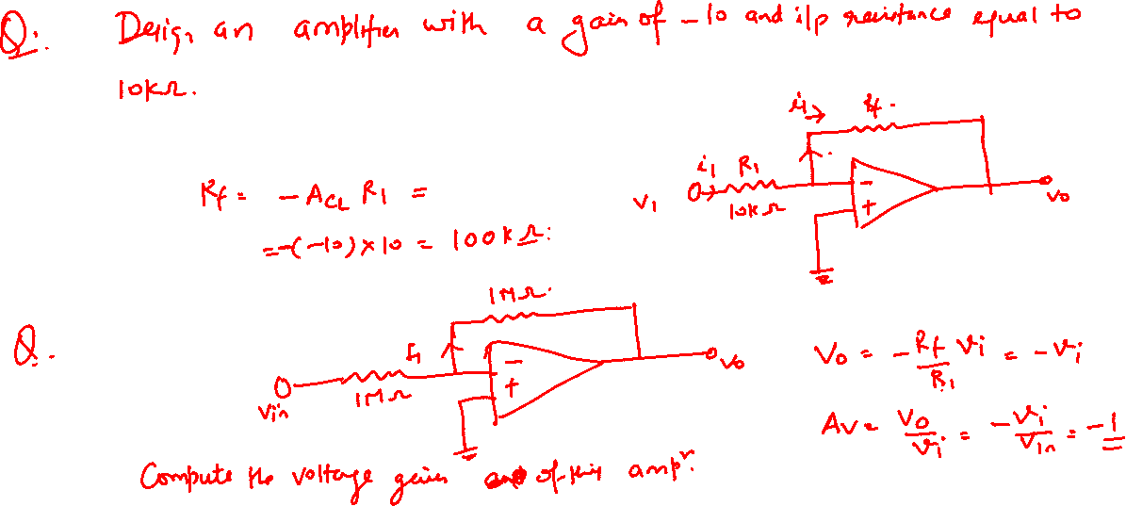

Slide 29
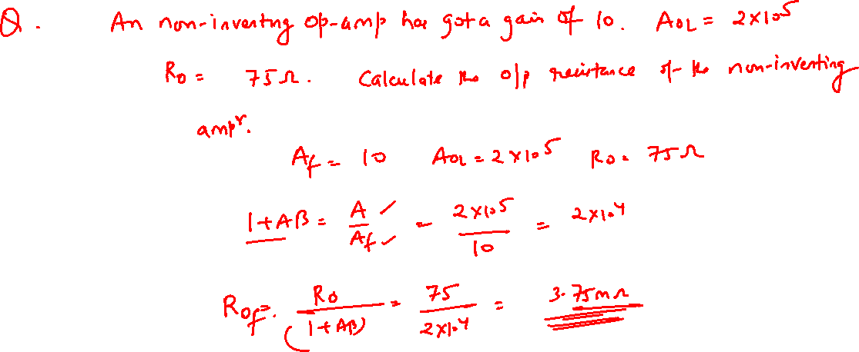

Slide 30
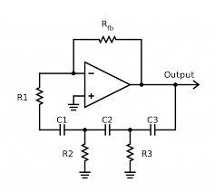
R-C Phase Shift Oscillator

Slide 31
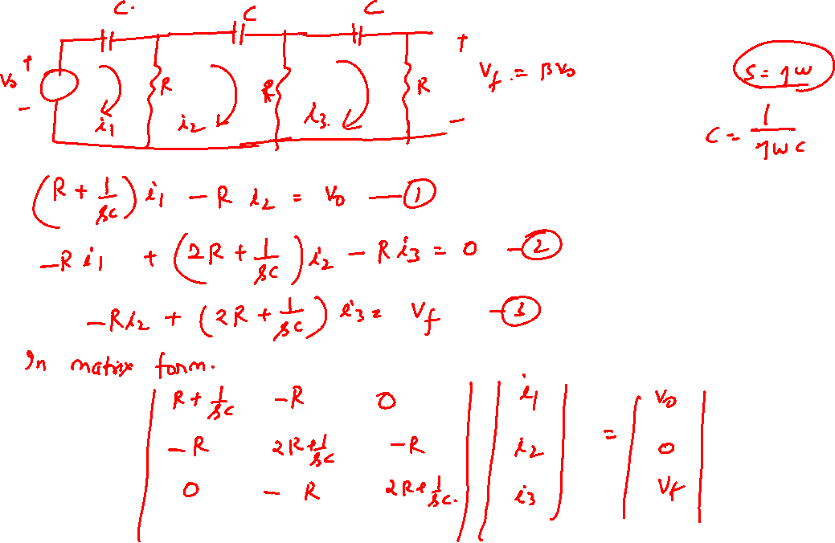

Slide 32
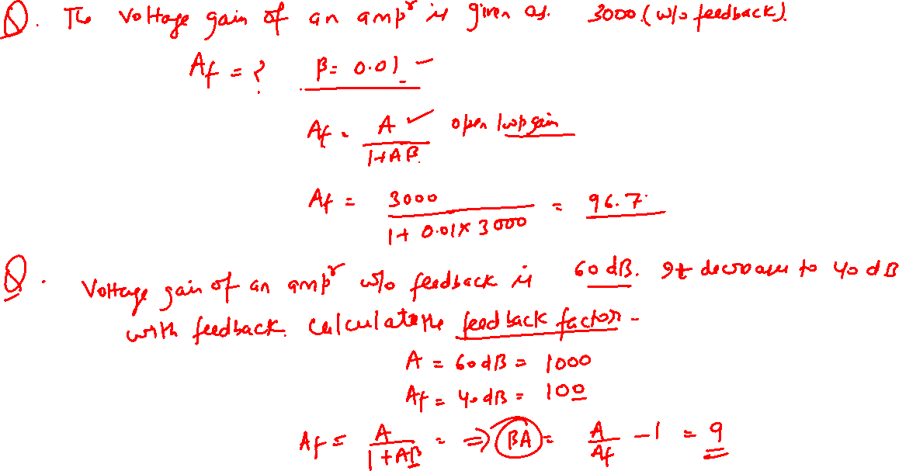

Slide 33
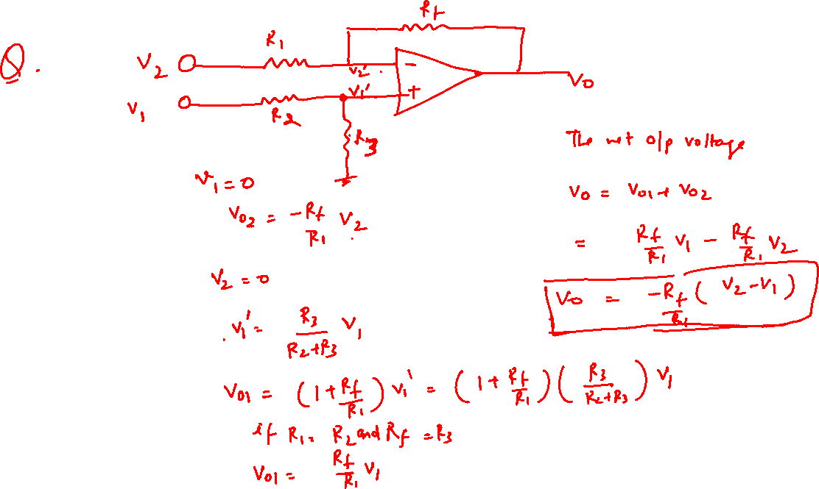

Slide 34
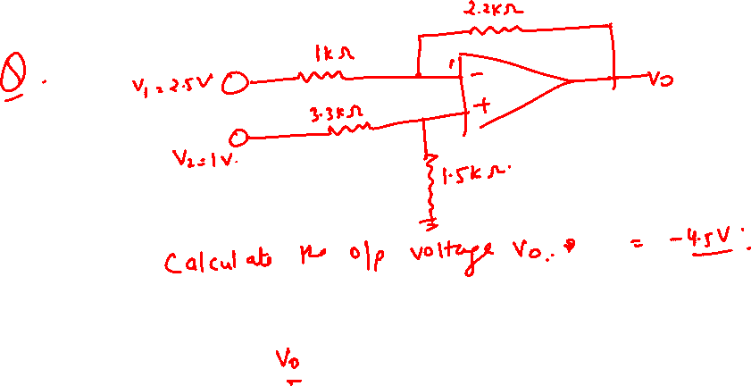

Slide 35
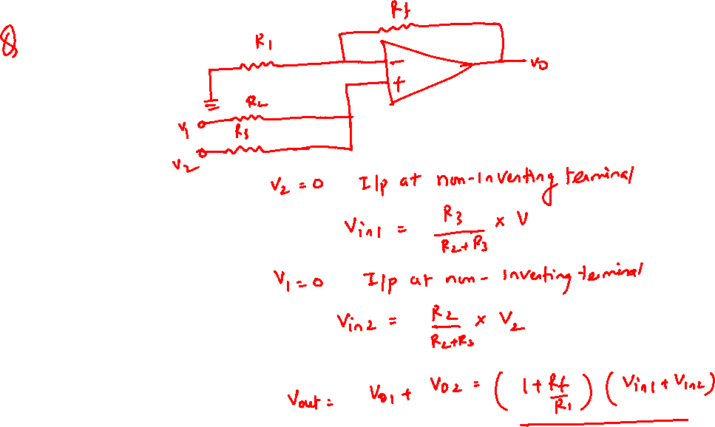

Slide 36
